Slide 1
Code Smells and Refactoring
Week 8

Slide 2
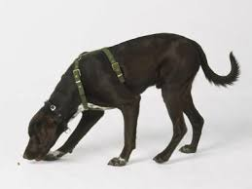

Code Smells
Does not exhibit bugs
Signs of bad code and may introduce bugs in future

Slide 3
Comments

Slide 4
Comments
Used to document
Application programmer interfaces (APIs)
Choices of data structure and algorithms
Don’ts
Over comment
Explain how the code works

Slide 5
Comments
Comments that reflect potential changes to be made in a different method are indication of code smells.
GoodCommentedStack.java; BadCommentedStack.java

Slide 6
Repeated Code

Slide 7
Repeated Code
Code fragments containing very similar code
BrokenLinkFinderSmell.java

Slide 8
Cohort Exercise 1
Remove the “repeated code smell” from BrokenLinkFinderSmell.java
BrokenLinkFinderNoSmell.java

Slide 9
Long Method
Depends on programming language and application
The general thumb rule is that the method should have a single, clear objective

Slide 10
Long Method
The Debit() method in AccountSmell.java has multiple responsibilities.
AccountSmell.java

Slide 11
Cohort Exercise 2
Write a CreditTransaction() method in the AccountSmell class which also records the last credit time. Refactor the code to remove the smells.
AccountWithCreditSmell.java; AccountNoSmell.java

Slide 12

BalckHole Classes
Classes start small
Adding more responsibility to a class attracts further responsibilities
Eventually the class behaves like a Blackhole

Slide 13
Example
(real-world project)
Executor.h (not in eDimension)

Slide 14
Data Class

Slide 15
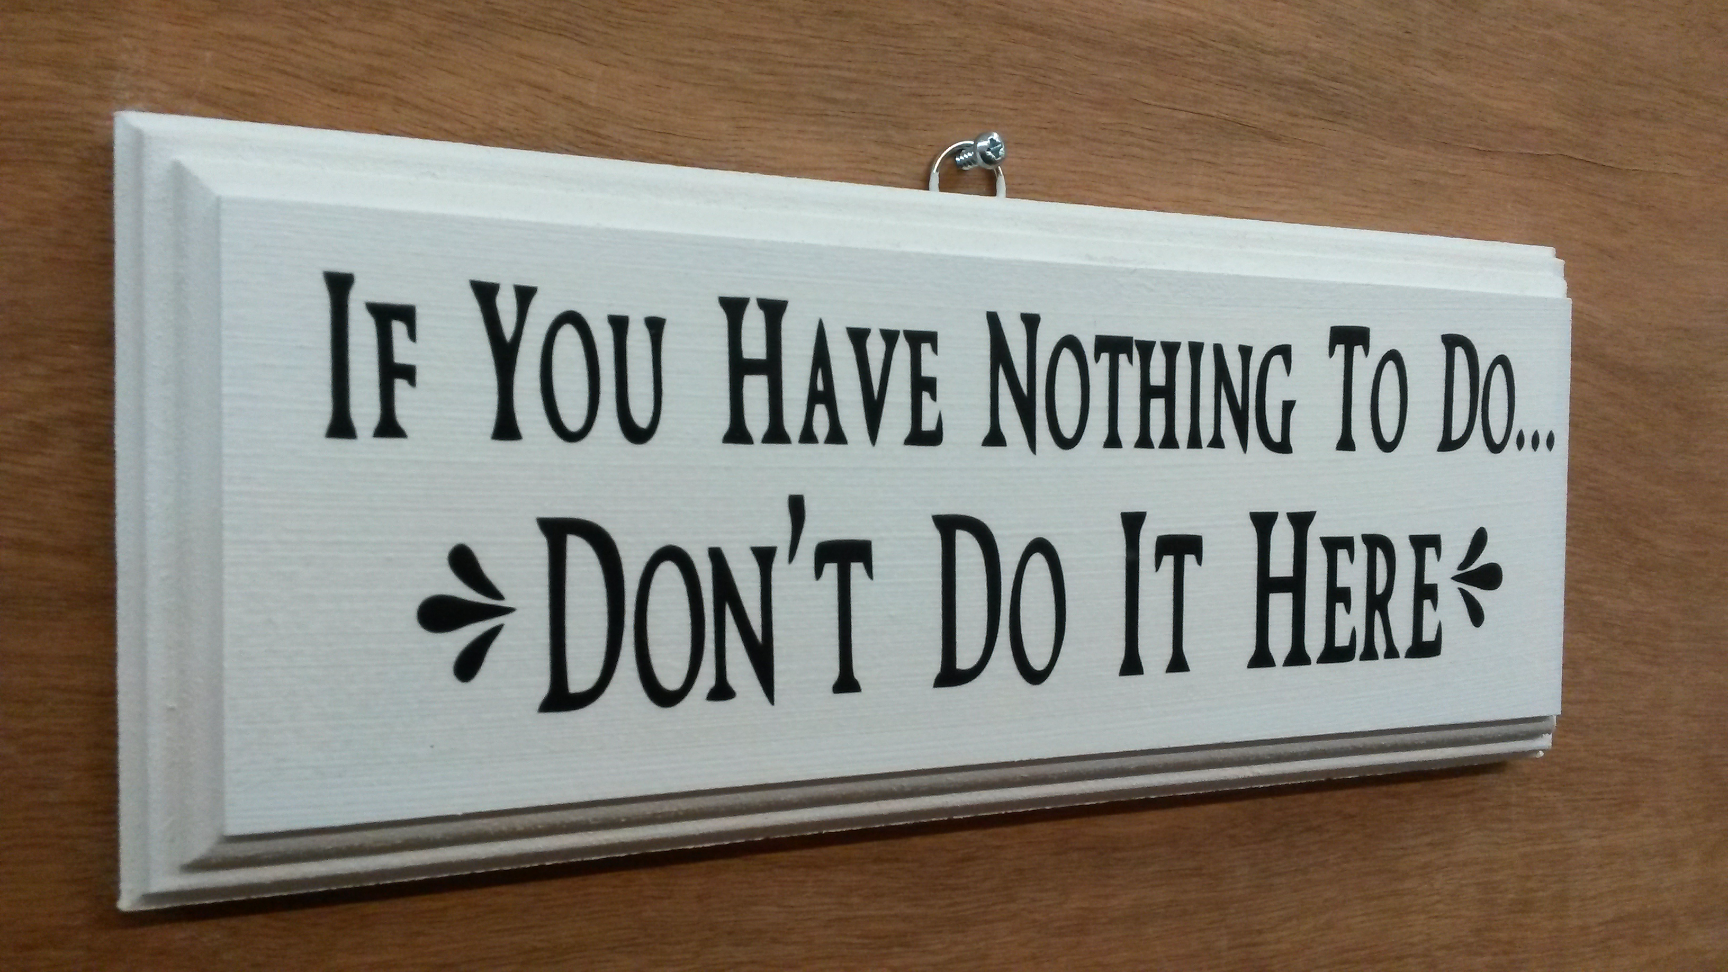
Data Class
Data classes are too small of a class without much responsibility

Slide 16
Data Class
Point class in DelegatingTracker.java does not have much responsibility.
DelegatingTrackerSmell.java; DelegatingTrackerNoSmell.java

Slide 17
Data Clumps

Slide 18
Data Clumps
Data clumps are opposite to data classes
It is better to create a class if a set of parameters are used repeatedly
DataClumpSmell.java; DataClumpClassSmell.java

Slide 19
Long Parameters

Slide 20
Example
(real-world project)
Executor.cpp (not in eDimension)

Slide 21
Shotgun Surgery

Slide 22
Shotgun Surgery
Adding a simple feature may need to change all over the code
It is like taking a shotgun and shooting all over the code
ShootTheAccount.java

Slide 23
Cohort Exercise 3
In ShootTheAccount.java, assume we wish to add a new feature that only personal accounts will become dysfunctional when balance drops below 500. All other type of accounts (say “business” account) are exempted from this exception. Change the file to add this feature.
ShootTheAccountPlus.java

Slide 24
Cohort Exercise 4
Remove the shot gun surgery code smell from ShootTheAccountPlus.java.
ShootTheAccountPlusNoSmell.java

Slide 25
Feature Envy

Slide 26
Feature Envy
If one class (A) is talking to another class (B) unusually frequent
It is like A is doing the job of B
In other words, A is more interested in the job of B than its own
LostInLove.java

Slide 27
Feature Envy
If one class (A) is talking to another class (B) unusually frequent
B should better take care of its own job
LostInLoveButSeparated.java

Slide 28
Feature Envy
If one class (A) is talking to another class (B) unusually frequent
They might better be together
LiveAsCouple.java

Slide 29
Long Message Chains

Slide 30
Long Message Chains
Should avoid calling a long sequence of messages without checks
E.g. A.B().C().D().E()
MessageChainSmell.java; MessageChainSmellBreak.java

Slide 31
Speculative Generality

Slide 32
Speculative Generality
Should avoid over engineering based on unlikely generalization
Violates the agile development principle
Concentrates on the features needed, throw away all other features
The art of maximizing the “work not done”
SpeculativeGeneralitySmell.java

Slide 33
Refused Bequest

Slide 34
Refused Bequest
Bad inheritance
Inherit multitudes of unnecessary methods
RefusedBequestSmell.java

Slide 35
Summary
Code smells are signs that the code might be turning a bad code and likely to introduce bugs in near future
Refactor code continuously and not at the end of the project
Reusable, flexible and maintainable code
Removing one code smell may introduce other code smells
Data class and data clumps
The presence of code smell is not conclusively a sign of bad code
Depends on application, programming language etc.

Slide 36
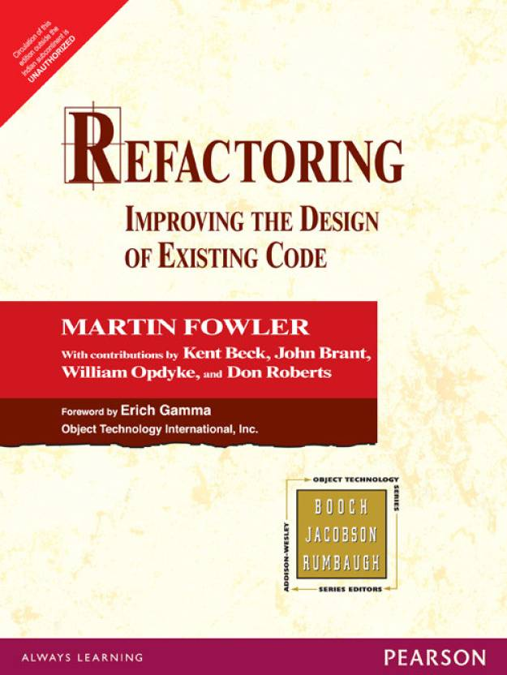
Reading
Refactoring: Improving the Design of Existing Code by Martin Fowler

